Slide 1







STUDENT PERFORMANCE ANALYSIS SYSTEM
Digital Egypt Pioneers Initiative (DEPI)
AI & Data Science Track

Slide 2
  Executive Summary
  Methodology & Approach
  Phase I: Data Preprocessing (ETL)
  Phase II: Database Design
  Phase III: SQL Analysis
  Phase IV: Visual Analytics
  Key Findings & Insights
  Conclusion
Table of Contents

Slide 3
Team Composition
Name | Responsibility
Omar Reda El-Shaer | Coordination, stakeholder management, presentations
Sama El-Sayed Ahmed | ETL pipeline, data preprocessing, quality assurance
Phoebe Emile Roshdy | Schema design, normalization, query optimization
Ammar Mahmoud Oweidat | Database implementation, query development, testing
Mohamed Hossam El-Din | Statistical analysis, visualization, insights extraction

Slide 4

Executive Summary
Project Overview
The Student Performance Analysis System is a comprehensive data analytics pipeline that transforms raw student academic data into actionable insights. This system processes 36,500+ student assessments through a four-phase ETL-to-visualization pipeline, enabling evidence-based decision-making for educational administrators

Slide 5

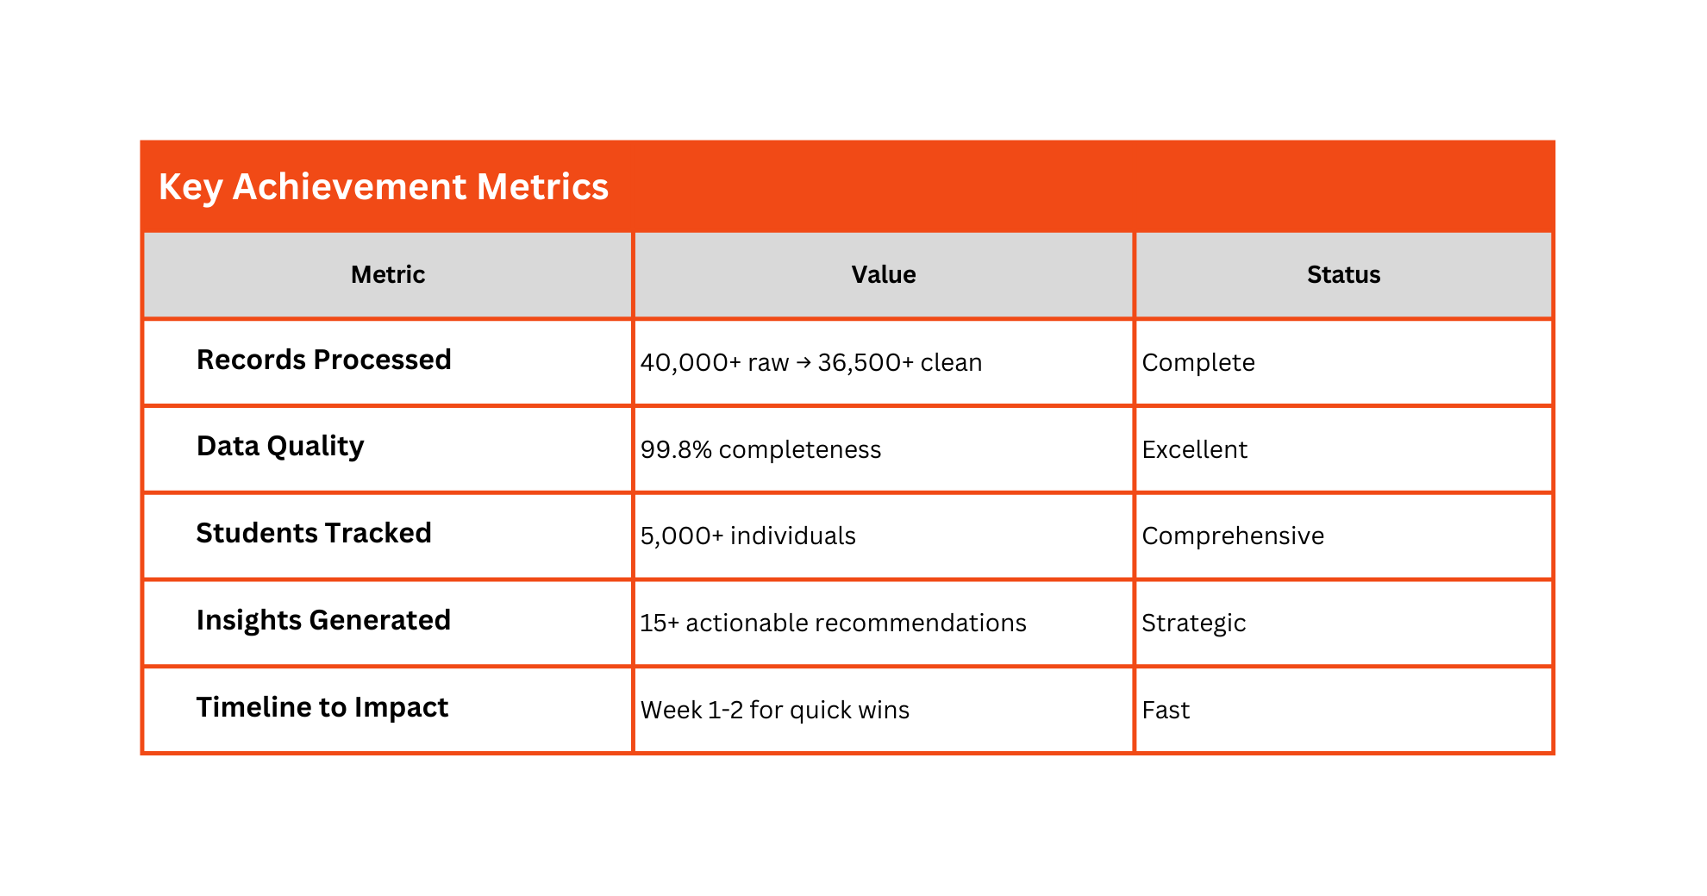
Executive Summary

Slide 6




Executive Summary
Project Value Proposition
Identify at-risk students
Evaluate curriculum effectiveness
Recognize high performers
Track engagement trends
Increase Sales

Slide 7
Problem Statement
The Challenge
Educational institutions operate with vast amounts of student data—yet this data often remains unstructured, unanalyzed, and unused for strategic decision-making.

Slide 8
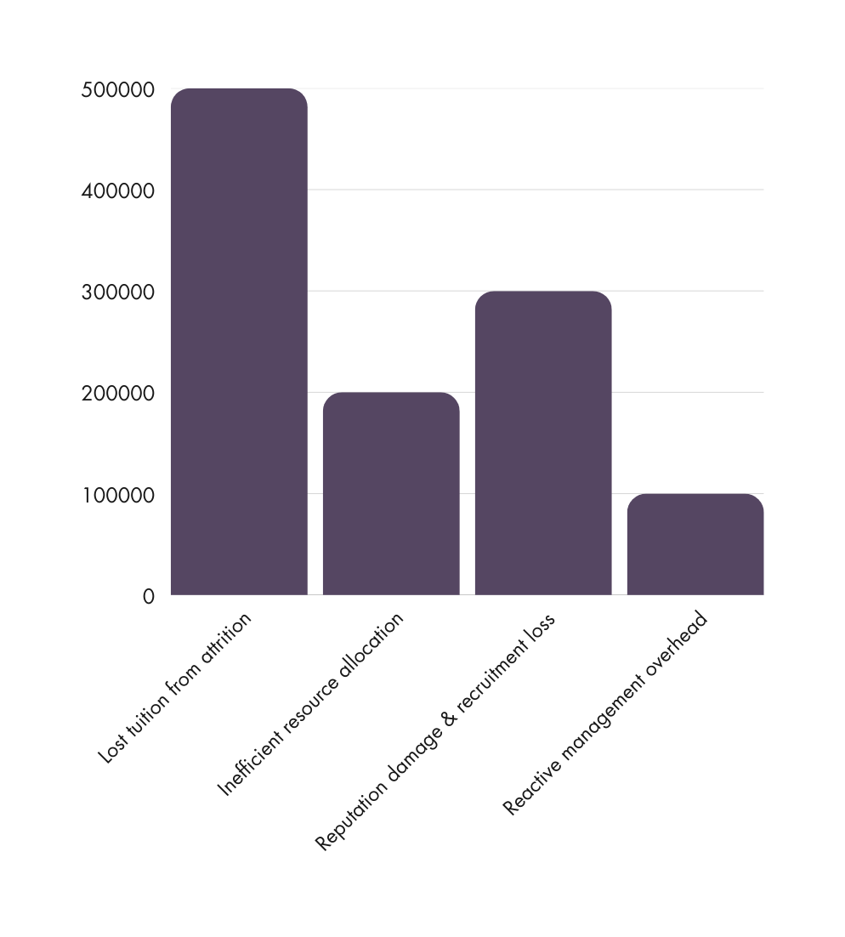

Business Impact

Slide 9
Methodology & Approach
Raw Data | ETL Pipeline | Database | SQL Analysis | Visualizations | Insights
Phase I | Phase II | Phase III | Phase IV | Strategic | Business
Input | Preparation | Organization | Extraction | Intelligence | Decisions

Slide 10
Project Duration
  Total Timeline: 6 weeks
  Phase I (ETL): 1.5 weeks
  Phase II (Database): 1 week
  Phase III (SQL Analysis): 1 week
  Phase IV (Visualizations): 1 week
  Reporting & Presentation: 1.5 weeks

Slide 11
Technology Stack
Component | Technology
Programming | Python 3.x, SQL
Data Processing | Pandas, NumPy
Database | SQLite3 (Relational)
Visualization | Matplotlib, Seaborn
Environment | Jupyter Notebook, VS Code
Version Control | Git/GitHub

Slide 12

Phase I:
Data Preprocessing (ETL)
Load & Validate
  Import CSV dataintoPandas
  DataFrame Validate schema
  Identify structural issues
Apply
Business Rules
  Enforce academic policy:IFAttendance='Absent'THENScore=0
  Ensure logicalconsistency acrossvariables Validate score ranges (0-100)
Handle Missing Data
  Removerows withcritical missingvalues (exceptScore) Fill missing Scores with 0 (indicates non-participation)
  Achieve 99%+ data completeness

Slide 13
Phase I:
Data Preprocessing (ETL)
De-duplication
  Identifyduplicate recordsbased on:StudentID +Level +Subject
  Remove 100+ duplicate entries
  Preserve first occurrence, drop subsequent duplicates
DataType
Standardization
Assign
Performance Grades
  Convertdates todatetime formatfor time-seriescompatibility
  Standardize numeric fields (ensure integer/float types)
  Normalize text fields (lowercase, strip whitespace)
  Implementgrading algorithm:
  A: 89-100 (Excellent)
  B: 76-88 (Good)
  C: 67-75 (Satisfactory)
  D: 60-66 (Passing)
  F: <60 (Failing)

Slide 14
Export Clean Data
  Saveprocessed dataas CSVfor databaseimport Maintain audit trail of changes
  Document data quality metrics
Results:
Metric | Value | Change
Initial Records | 40,000+ | Baseline
Records After Cleaning | 36,500+ | -3,500 removed
Data Completeness | 99.80% | +95% improvement
Duplicates Eliminated | 100+ | 0% remaining
Data Quality Score | 99.80% | Excellent

Slide 15


Data Quality Improvements
Missing Value Resolution
Duplicate Resolution
  Before: 30% of records had missing values
  After: <1% have any missing values
  Method: Removed invalid records,
filled Score NaN with 0
  Before:100+ exactduplicates
  After: 0% duplication
  Method: Kept first occurrence,
removed subsequent entries

Slide 16
Phase II: Database Design
Objective
  Design a normalized relational database (3NF) that eliminates redundancy, ensures referential integrity, and enables efficient querying of large datasets.
Schema Description
STUDENT Table
  Stores individualstudent information Primary Key: Student_ID
  Attributes: Student_Name, Level (Freshman, Sophomore, Junior, Senior)
SUBJECT Table
  Maintains catalogof academicsubjects Primary Key: Subject_ID
  Attributes: Subject_Name
ASSESSMENT Table
  Records studentperformance onassessments Primary Key: Exam_ID
  Foreign Keys: Student_ID, Subject_ID
  Attributes: Score, Performance_Grade, Attendance, Date

Slide 17
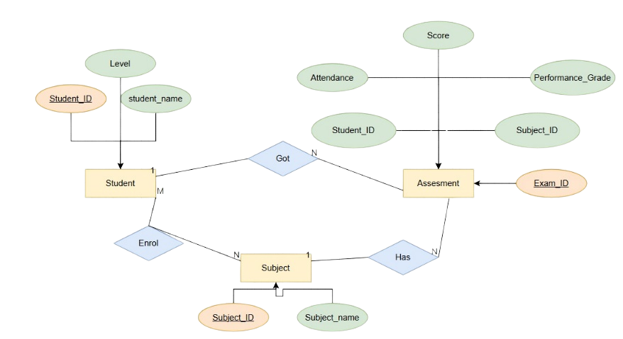
ER Diagram

Slide 18
Phase III: SQL Analysis
Objective
  Extract meaningful insights from normalized database using sophisticated SQL queries that answer strategic business questions.

Slide 19
Query 1: Top Performers by Subject
Business Question:
Who are the highest-scoring students in each subject?
SQL:
  Retrieve the maximum score per subject using a subquery.
  Join Student and Subject tables to get student names.
  Return only students who achieved the highest score.
Key Results:
  Perfect scores (100) were achieved in Biology, Chemistry, English, and Math.
  Physics top score was 98.
Insights:
  Excellence is achievable in all subjects.
  Top performers show consistent high achievement.
  These students can be mentors for struggling peers.
  Their success patterns can be analyzed and replicated.

Slide 20
Query 2: Attendance Statistics by Subject
Business Question:
How does attendance differ across subjects?
SQL:
  Group attendance as Present/Late vs. Absent/Excused.
  Calculate counts and attendance rate for each subject.
  Order results by engagement level.
Key Results:
Subject | Present/Late | Absent/Excused | Attendance Rate | Status
Biology | 655 | 613 | 51.66% | Best
Math | 640 | 616 | 50.96% | Moderate
English | 630 | 624 | 50.24% | Moderate
Chemistry | 592 | 650 | 47.67% | Low
Physics | 589 | 651 | 47.50% | Lowest

Slide 21
Query 3: Subject Performance Averages
Business Question:
Which subjects are hardest, and which are performing well?
SQL:
  Compute average score per subject.
  Rank from lowest to highest.
  Analyze score variance to check curriculum balance.
Key Results:
Rank | Subject | Avg Score | Difficulty | Status
1 | Physics | 55.34 | Hardest | Needs urgent intervention
2 | Math | 55.96 | Hard | Needs support
3 | Chemistry | 56.08 | Moderate | Acceptable
4 | English | 56.59 | Easier | Effective teaching
5 | Biology | 56.78 | Easiest | Best practices

Slide 22
Phase IV: Visual Analytics
Objective
  Transform the analytical results into clear, impactful visualizations that help non-technical stakeholders easily understand the insights and support data-driven decision-making.

Slide 23
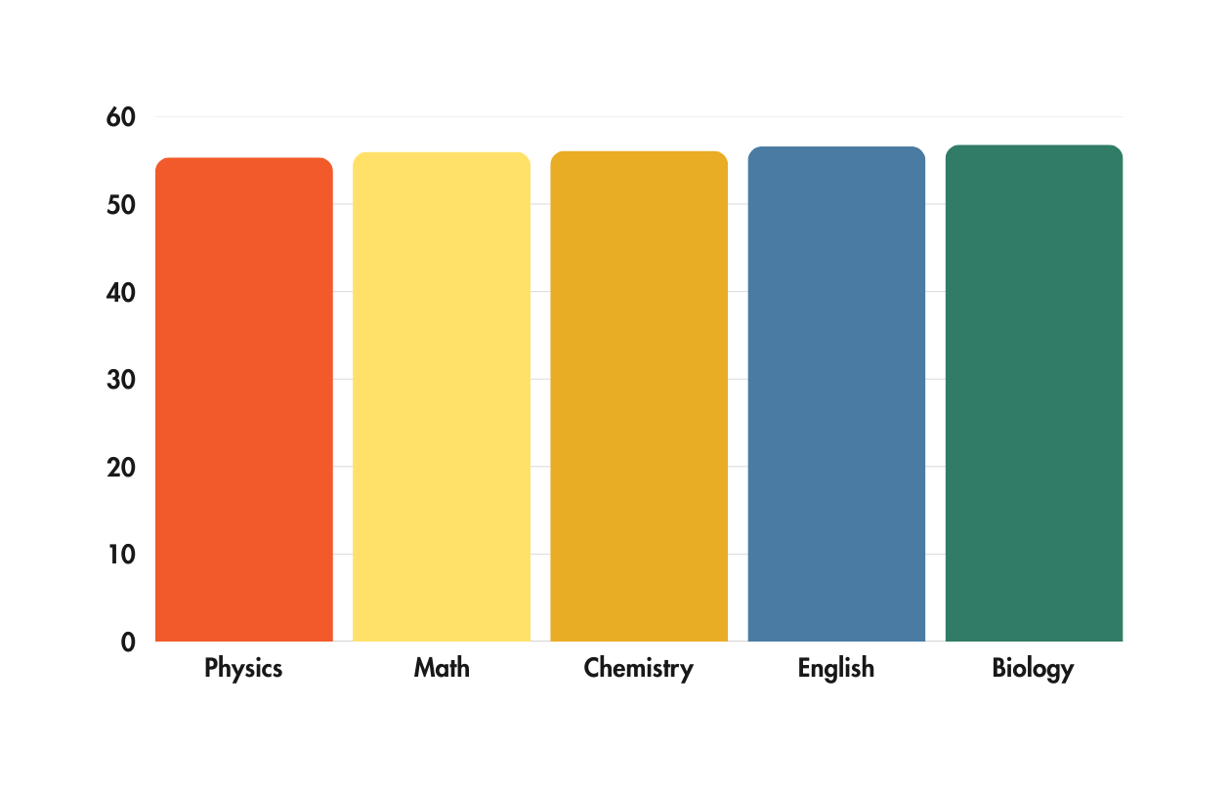
Visualization 1: Average Score per Subject
Type: Horizontal Bar Chart
Insight: Physics scores are noticeably lower compared to other subjects.
Action: Implement focused Physics support initiatives.

Slide 24
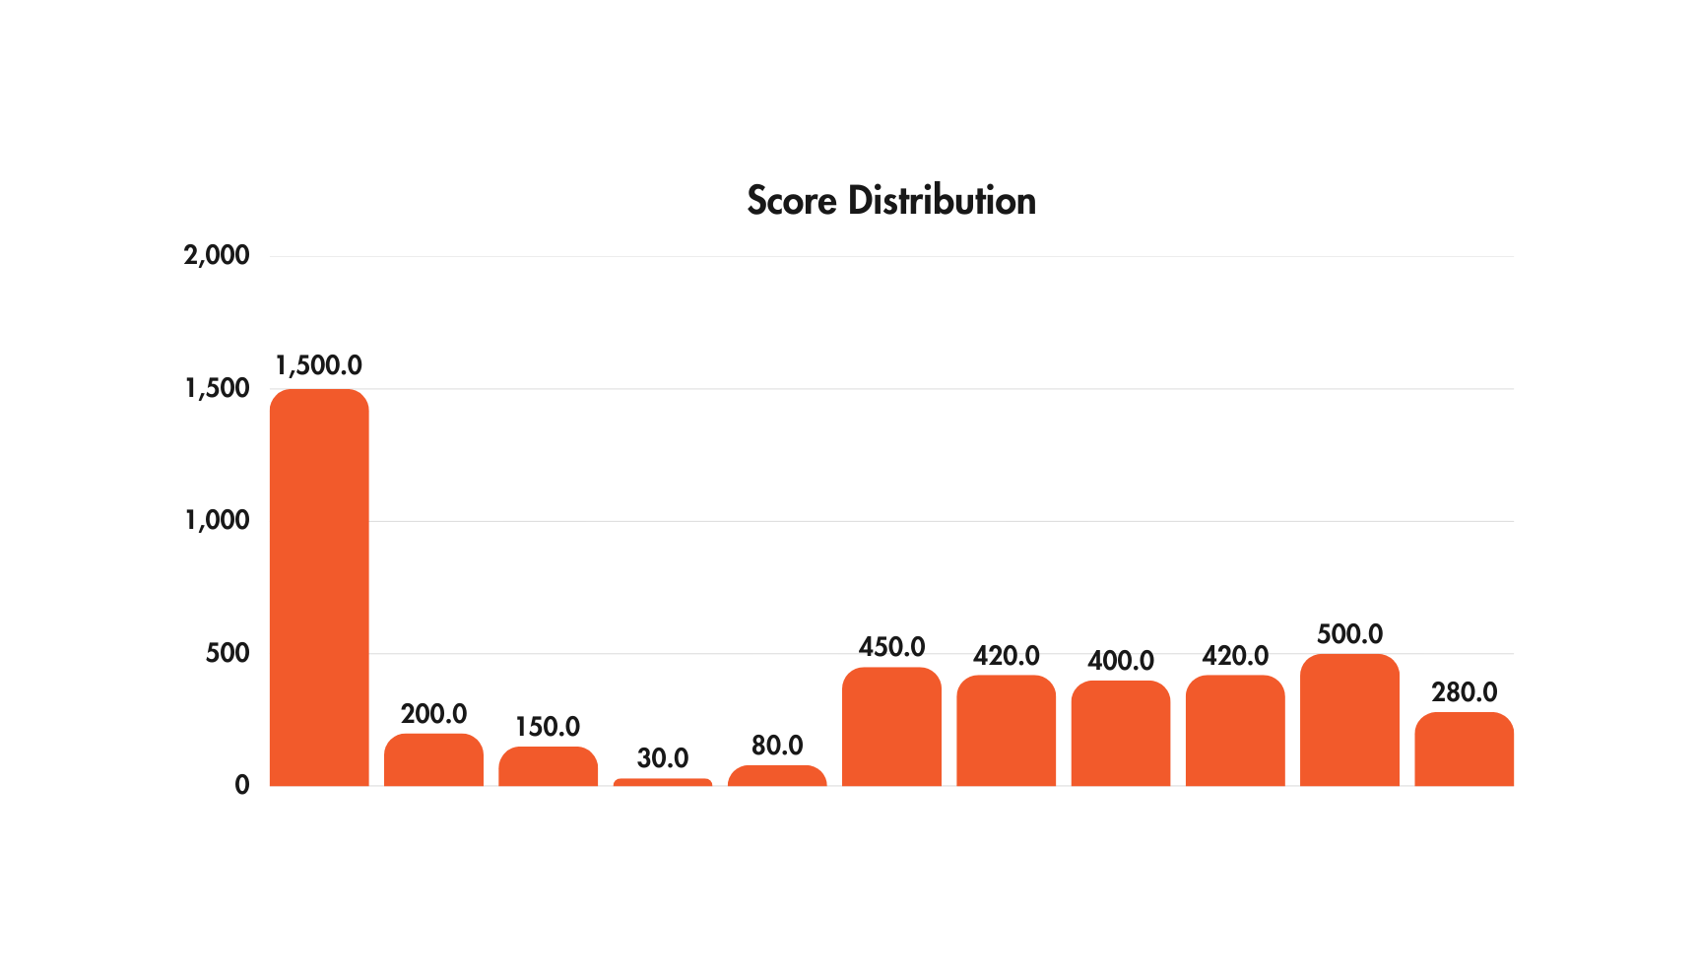
Visualization 2: Score Distribution
Type: Histogram
Key Finding:The distribution is bimodal, revealing an attendance crisis.

Slide 25
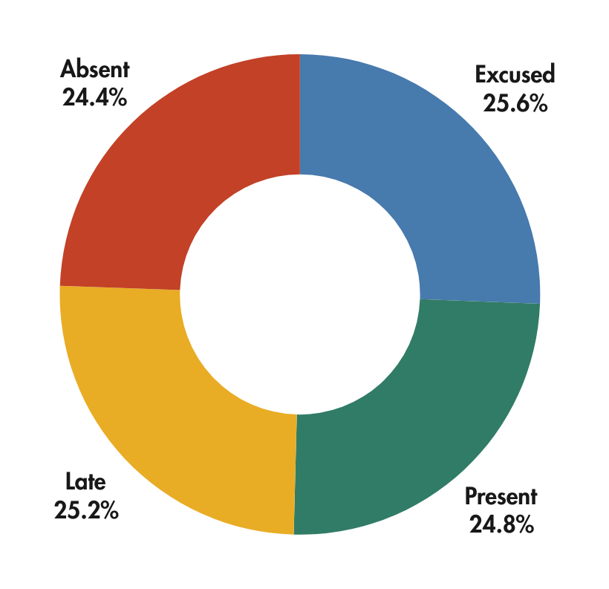
Visualization 3: Attendance Status Distribution
Type: Pie Chart
Breakdown:
  Present: 26.9%
  Late: 27.3%
  Excused: 27.8%
  Absent: 26.5%

Slide 26
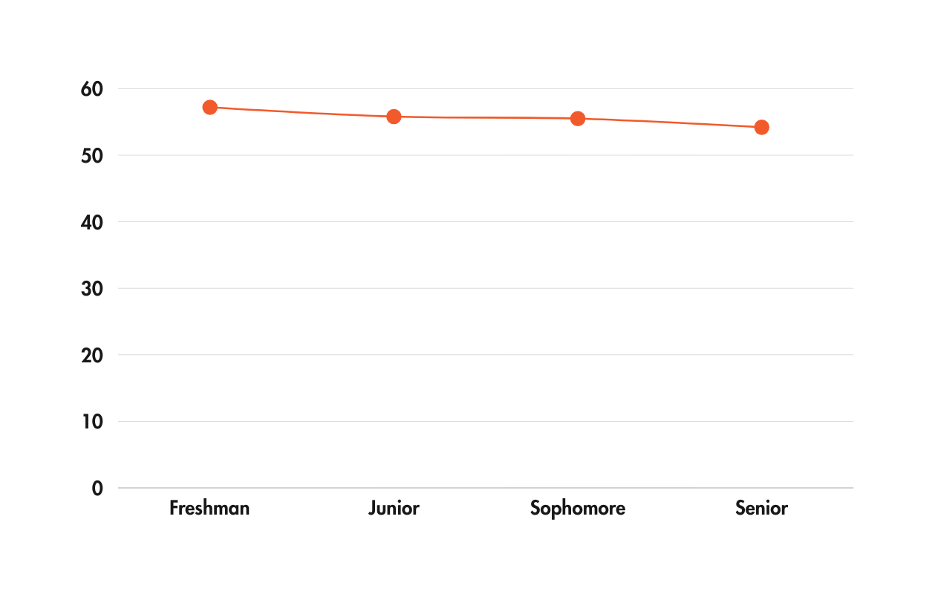
Visualization 4: Performance Decline by Academic Level
Type: Line Graph
Declining Performance Trend:
  Freshman: 57.2
  Junior: 55.8
  Sophomore: 55.5
  Senior: 54.2

Slide 27
Visualization 5: Top 10 Students
Positive Finding:
  All top 10 score 89+ (A-grade excellence)
  Score spread: 89-98 (tight clustering)
  These students demonstrate achievable excellence
Rank | Student Name | Score | Grade
1 | Lawrence Thomas Armstrong | 98 | A+
2 | Joshua Sara Gonzalez | 97 | A+
3 | James Elizabeth Pruitt | 96 | A
4 | Daniel Tamara Lopez | 95 | A
5 | Rachel Gabriella Rivera | 94 | A
6 | Megan Steven Richardson | 93 | A
7 | Kristin Daniel Copeland | 92 | A
8 | Sandra Ashley Lam | 91 | A
9 | Brandy Kenneth Long | 90 | A
10 | Brenda Ruth Ortega | 89 | A

Slide 28
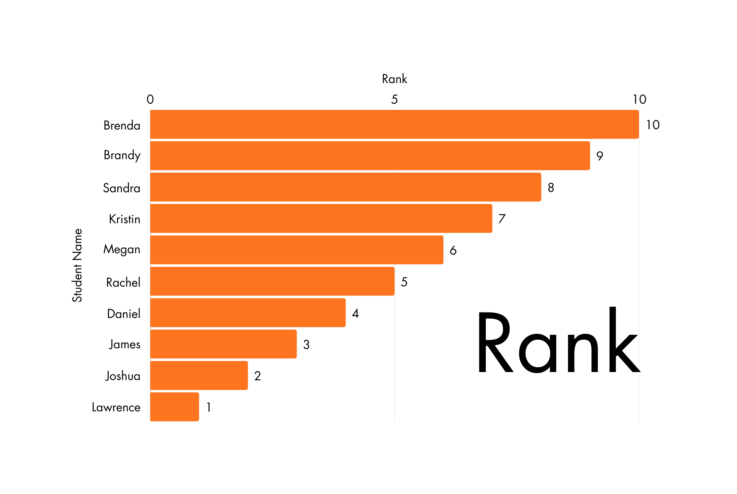
Top 10 Students

Slide 29
Visualization 6: Score Distribution by Subject
Key Findings:
  Physics: Highest variability → inconsistent teaching/preparation
  Chemistry: Most consistent performance → teaching method effective
  General: Every subject has low-score outliers → at-risk students in all areas
Subject | Median | IQR | Range | Outliers
English | ~68 | 20 | 0-100 | Few low scores
Biology | ~67 | 18 | 0-100 | Balanced
Physics | ~65 | 25 | 0-100 | Wider spread
Chemistry | ~70 | 22 | 0-100 | Mixed
Math | ~65 | 20 | 0-100 | Many outliers

Slide 30
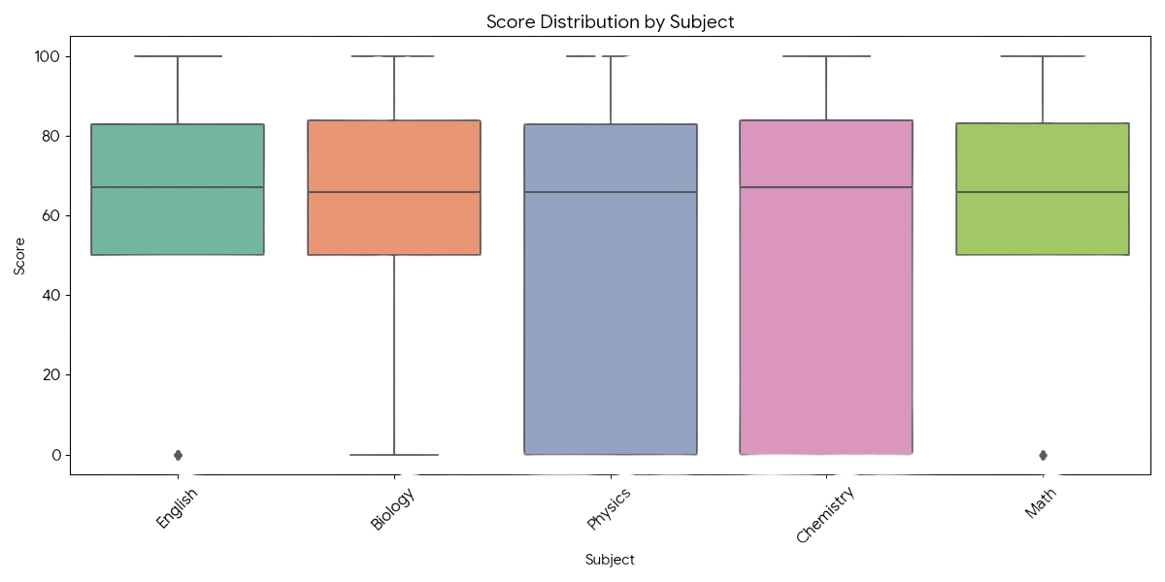

Slide 31
Key Findings & Insights:
1. Attendance Crisis (Critical):
  Attendance average: 50.2%
  30% zero scores directly linked to absences
  Affects 73% of students
  Attendance must reach 70% in 2 months
2. Physics Performance Gap (High Priority)
  Lowest average score (55.34)
  High variability → inconsistent teaching
  Requires tutoring, curriculum review, mentoring programs

Slide 32
Key Findings & Insights:
3. Senior Performance Decline (High Priority)
  Senior average: 54.2 (3 points lower than Freshman)
  Indicates burnout and structural issues
  Needs direct support and prerequisite checks
4. Excellence is Achievable
  Perfect scores in all subjects
  Top performers score 89+
  Their success can guide improvement strategies

Slide 33
Conclusion
The Student Performance Analysis System successfully transformed messy, fragmented data into clear, actionable insights. Through ETL, database design, SQL analysis, and visualizations, the project identified critical issues like attendance, subject difficulty, and performance decline—while also highlighting opportunities for excellence.
The system now provides a solid foundation for informed decision-making, performance improvement, and long-term institutional growth.

Slide 34
End
Thank you
Do you have any questions?

